Slide 1
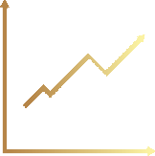
RECESSION?
Toledo, Ohio
Robert Morgan
November 16, 2023

Slide 2
MONETARY Vs. FISCAL POLICY

Slide 3
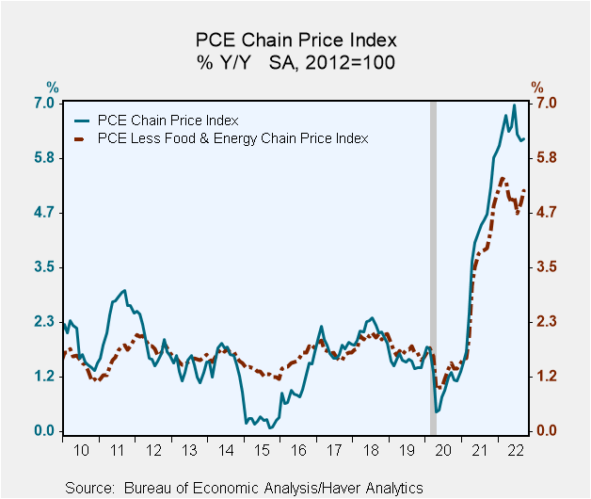
Monetary Policy

Slide 4
Monetary Policy

Slide 5
Monetary Policy
Real GDP
Actual
Consensus Forecast for 2023 As Of 12/31/2022
2022

Slide 6
Monetary Policy
Real GDP - 2023 Forecasts As of 12/31/2022
Reported Actual
Current Forecast

Slide 7
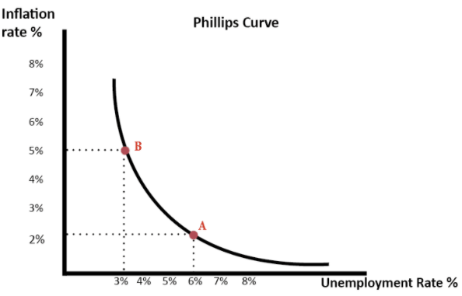
Monetary Policy

Slide 8
Monetary Policy
INFLATION
Core PCE Price Index Y/Y

Slide 9
Monetary Policy
PCE Price Index Y/Y Unemployment Rate

Slide 10
Monetary Policy

Slide 11
Monetary Policy
CONSUMER CONFIDENCE

Slide 12
Monetary Policy

Slide 13
Monetary Policy

Slide 14
Monetary Policy

Slide 15
Monetary Policy
TREASURY CURVE

Slide 16
Fiscal Policy

Slide 17
Fiscal Policy

Slide 18
Fiscal Policy

Slide 19
MONETARY Vs. FISCAL POLICY

Slide 20
Monetary Policy Expectations
Policy Will Remain Restrictive
Managed Rates Are At The Terminal Level
The Yield Curve Will Turn Positive
The Fed Will Reduce Managed Rates Slowly Beginning In Late 2024

Slide 21
Fiscal Policy Expectations
Political Instability
2. Strikes and Labor Unrest
3. Student Loan Payments
4. Wars
5. Consumer/Business Confidence
6. Environment Investment
7. The Election Cycle

Slide 22
Conclusion
Our Forecast

Slide 23
REAL GDP

